Slide 1

Nosferatu
We will Hash Slinging Slash your electric bill
By: Gunnar Boehm, Dan Cardin, Joe Gorse, Connor Igo, Chris Holtsnider,
Advisor: John Kimani
2015 EECE Capstone

Slide 2
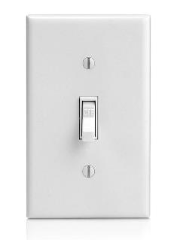
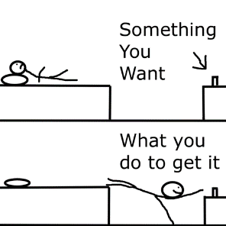
The Problem
Forgetting to turn your lights off when you leave your house
Needing to get out of your comfortable bed to turn off lights
Bumping into furniture on your way to the bathroom late at night
Notes:
Connor
Changes needed here? I think we’re good.

Slide 3
Introduction
Nosferatu is an energy efficient, convenient new way to control your home lighting. Bringing Wi-Fi and motion sensors to your light switches allows you to set schedules and rules to manage your home lighting, as well as save money, energy and time.
Notes:
Connor

Slide 4
Uses
Walk into a room, motion sensor turns light on automatically
With rules you can set a switch to not respond to motion at certain times of day
Going away on vacation, can set a schedule to turn on some house lights to deter robbers
Turn off/on a light from your computer or phone anywhere
In bed
At work
At Conor Larkins
Save on your electric bill by having your lights turn off after time intervals or certain times of day

Slide 5
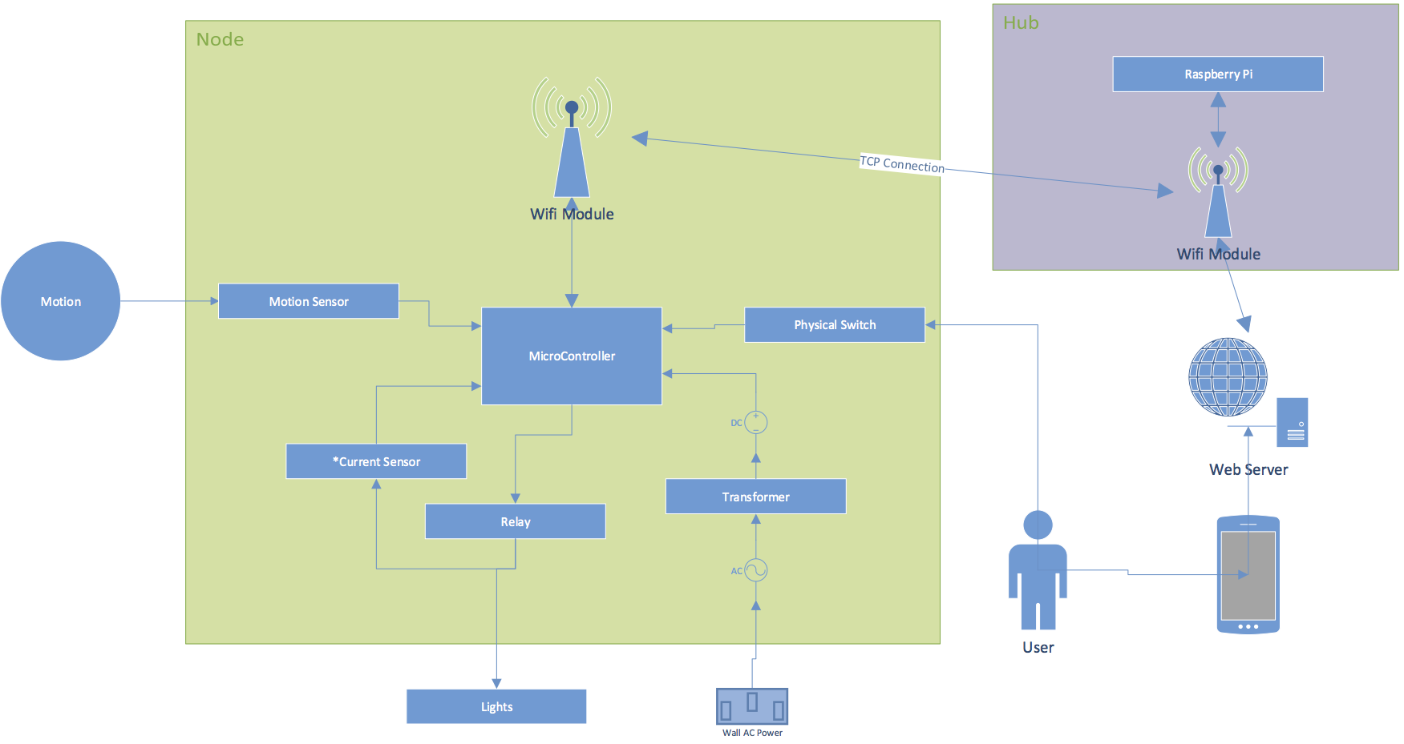
Hardware Layout
Notes:
Chris
Need to update this chart: Server is on Rpi, not external. Joe doesn’t have Visio so can someone else do that?

Slide 6
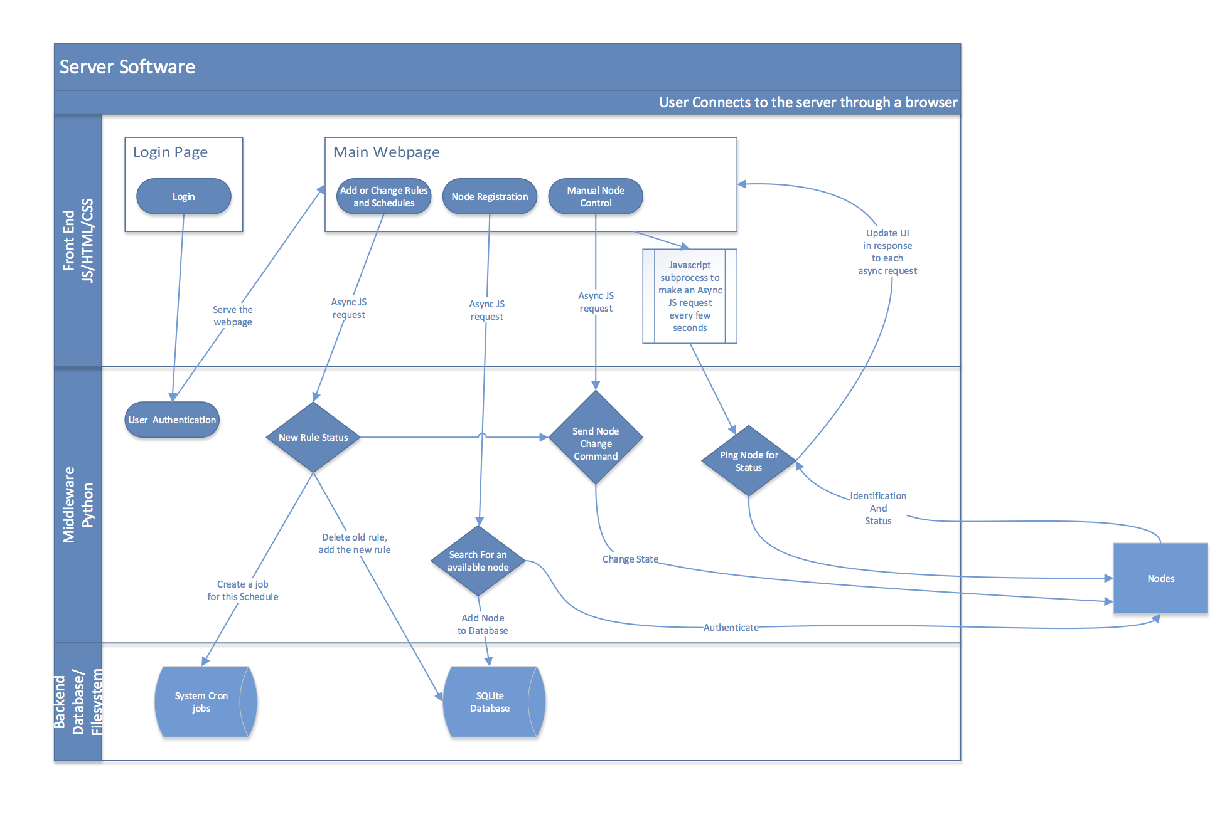
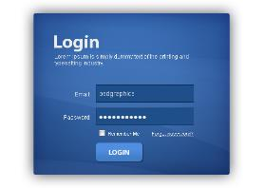

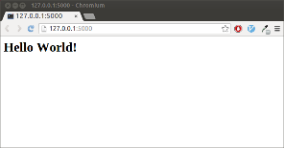
Software Layout
Coffeescript (JS is the worst)
Angular
Ajax
Python
Flask
SQLAlchemy
Celery (Maybe)
PostgreSQL
Notes:
Dan
Need to update this:
Updated screenshot to replace hello world
Updated login screenshot

Slide 7
Timeline
ID | Task Name | Start | Finish | Duration | Assigned To
1 | Assemble Node | 9/11/15 | 9/12/15 | 2d | Chris
2 | Setup Raspberry Pi | 9/11/15 | 9/11/15 | 1d | Joe
3 | Create Web Server | 9/12/15 | 9/13/15 | 2d | Dan
4 | Setup Flask | 9/12/15 | 9/13/15 | 2d | Gunnar
5 | Hub -> Microcontrollers Connection | 9/14/15 | 9/20/15 | 7d | Joe
6 | Microcontroller -> Hub Connection | 9/21/15 | 9/27/15 | 7d | Connor
7 | Relay Interface (Software) | 9/14/15 | 9/15/15 | 2d | Connor
8 | Motion Sensor Logic | 9/16/15 | 9/17/15 | 2d | Joe
9 | Web Server Logic (Base) | 9/25/15 | 10/1/15 | 7d | Dan
10 | Expand UI | 10/2/15 | 10/8/15 | 7d | Gunnar
11 | Design Node Enclosure (Create/Print) | 10/2/15 | 10/13/15 | 12d | Dan / Gunnar
12 | Setup Test Enviornment | 10/12/15 | 10/13/15 | 2d | Everyone
13 | Running Tests in Lab | 10/14/15 | 10/27/15 | 14d | Everyone
14 | Base Project Complete | 8/1/15 | 8/1/15 | 0d | Everyone
15 | Advanced Features | 10/28/15 | 11/16/15 | 20d | Everyone
16 | Presentation Prep | 11/17/15 | 11/30/15 | 14d | Everyone
Notes:
Joe – at the end w/ advanced features mention a few stretch goals we may try
Do we need this slide?

Slide 8
Budget
Part List | Cost Estimate Per Part | Quantity | Cost Estimate(-tax)
Arduino | $10.00 | 4 | $40.00
Motion Sensor | $10.00 | 4 | $40.00
Wifi Module | $7.00 | 4 | $28.00
Relay | $8.00 | 4 | $32.00
Transformer | $7.00 | 4 | $28.00
Micro SD Card | $13.00 | 1 | $13.00
Button | $0.50 | 4 | $2.00
LED | $0.35 | 4 | $1.40
Rasberry Pi | $42.00 | 1 | $42.00
Wifi Source Module | $20.00 | 1 | $20.00
Wall Adapter | $3.00 | 1 | $3.00
Programming Board | $15.00 | 1 | $15.00
3D Printing Materials | $20.00 | 1 | $20.00
Totals |  |  | $284.40
Notes:
Joe
Do we need this slide?

Slide 9
What makes Nosferatu special
Compared to Wi-Fi lightbulbs
Don’t need to replace an expensive lightbulb whenever it dies
More sophisticated and synchronized system/setup
Compared to similar switches (such as the Belkin WeMo)
Motion Sensor
Rules
Web API
Cheaper
Notes:
Gunnar

Slide 10
Conclusion
Nosferatu is cheaper than the competition
Nosferatu is easier to use
Nosferatu is the most convenient way to manage your home lighting
“I haven’t touched a light switch in weeks, 10/10” – Dan Cardin
“Package still hasn’t arrived 1/5” – Amazon Reviewer squidw@rd
“Switch works great! 9/10, 10/10 with rice” –/u/DO_U_EVN_SPAGHETTI
Notes:
Gunnar
L

Slide 11
Questions?
Notes:
Everyone

